Slide 1
Combined physical and monetary presentations
Sjoerd Schenau

Slide 2
Content
General introduction: integration within SEEA
Core tables and acocunts
Combined presentations for water
Exercise

Slide 3
Integration within SEEA-CF
Strength of SEEA: consistent application of accounting rules, principles and boundaries in organisation of physical and monetary information.
Link between measures of flows of goods and services in physical and monetary terms as reflected in monetary and physical supply and use tables.
Link between changes in the stock of environmental assets over an accounting period and the use of extracted natural resources as an input to economic production, consumption and accumulation.
Connection between the measures of production, consumption and accumulation in monetary terms and measures of flows of income Integrating and presenting the accounts between different sectors.
Functional accounts
Notes:
An important part of this integration entails recording physical flows of natural inputs
from the environment and flows of residuals generated through economic activity. The use of
common product and industry classifications, and consistent definitions and measurement
boundaries is important in optimizing the potential for analysis.
The connection between asset accounts and supply and use tables is of interest in this area.
These sectoral flows of income are reflected in a sequence of economic
accounts and balancing items, such as value added and saving. Importantly, these
balancing items can be adjusted for depletion so that estimates of the monetary cost of using
up natural resources can be deducted from conventional economic aggregates such as GDP
and saving to yield depletion-adjusted aggregates.

Slide 4
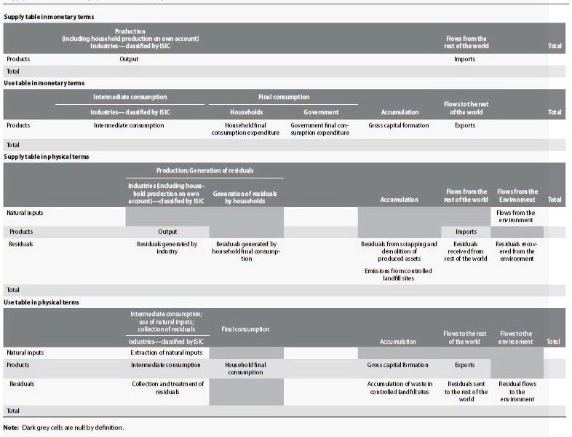
Integration of supply and use tables in physical and monetary terms
Notes:
the use of common classifications and terminology for the measurement of flows of products
and the use of common boundaries between the economy and the environment. Consequently,
flows recorded in monetary terms that focus on the exchanges of products between
economic units are, in broad terms, the same set of flows of products measured in physical
terms.
The integration of supply and use tables in physical and monetary terms is the basis
for the compilation of extended supply and use and input-output tables which are often used
in environmentally extended input-output analysis.

Slide 5
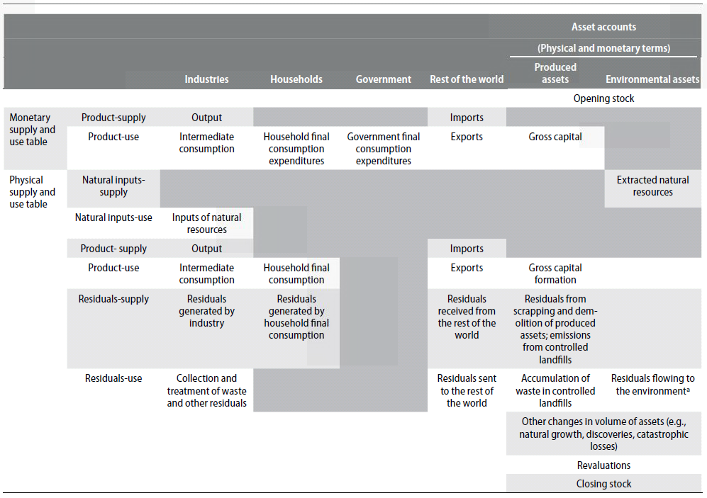
Integration of asset accounts and supply and use tables
Notes:
The integration of information from asset accounts and supply and use tables is of
particular relevance in the analysis of natural resources.

Slide 6
The sequence of economic accounts
SNA: sequence of economic accounts
Derivation of balancing items (GDP, GNI etc.)
Balancing items can be defined so as to take into account the depletion of natural resources
→ Depletion adjusted net value added, depletion adjusted net operating surplus, etc
Notes:
In monetary terms, monetary supply and use tables and asset accounts record much of
the information of interest in the assessment of the interactions between the economy and the
environment. However, there are a range of other monetary transactions and flows that are
of interest, such as payments of rent for the extraction of natural resources, and subsidies and
grants from government units to other economic units in support of environmental protection
activity. The SNA records all of these flows in a presentation referred to as the sequence
of economic accounts.
A particular feature of the sequence of economic accounts is the derivation of balancing
items. Typically, there is not a balance between relevant inflows and outflows. Thus, a
balancing item is introduced. The balancing items provide information in their own right
but also link the sequence of accounts together. Key balancing items include value added,
operating surplus, saving and net lending/borrowing. Economy-wide aggregates can also be
constructed such as gross domestic product (GDP) and gross national income (GNI).
Balancing items can be defined so as to take into account the
depletion of natural resources. Thus, measures of depletion-adjusted net domestic product,
depletion-adjusted net value added by industry, and depletion-adjusted net saving by institutional
sector are defined as part of the full accounting framework.

Slide 7
Adjusted National income for depletion

Slide 8
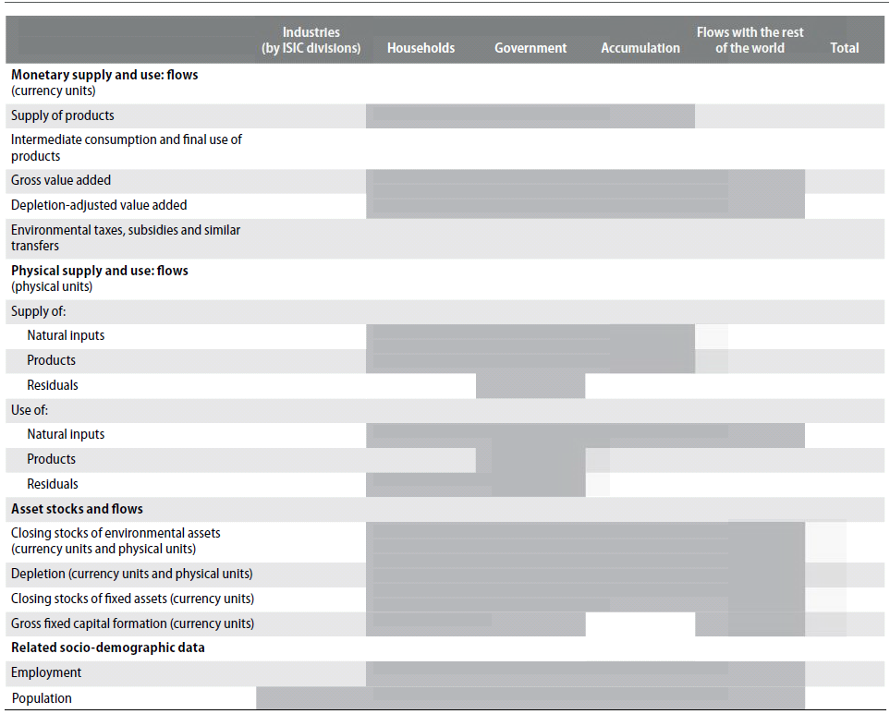
Possible structure for combined presentations

Slide 9
Questions ?

Slide 10
Exercise
Environmental accountants should not only compile the accounts, they should also be able to explain the data to the users.
Please assess the two core tables for water for 2005 and 2010. Evaluate the main changes that occurred between these two years.
Work in a group. Discuss the results. What are the 5 most important messages you deduce from this data?
Prepare a short presentation where you present the 5 most important messages and also explain why yiu think this is important.

Slide 11
Water core table for 2005

Slide 12
Water core table for 2010

